Slide 1
WELCOME
TO
phd public VIVA voce
^{18th} ^{februAry 2022}

Slide 2

EFFECT OF YOGIC PRACTICES WITH AND WITHOUT DIET
MODIFICATIONS ON SELECTED RISK FACTORS AMONG
ADULT WOMEN WITH OLIGOMENORRHEA
DOCTOR OF PHILOSOPHY
IN
YOGA
DEPARTMENT OF YOGA
TAMIL NADU PHYSICAL EDUCATION AND SPORTS UNIVERSITY
CHENNAI – 127
Submitted By Under the Guidance
Mrs. M. HEMAMALINI of
(Reg.No.A1701YOFM123) Dr. V. DURAISAMI

Slide 3
INTRODUCTION
Women from all walks of life, and from all parts of the world, are beginning to appreciate the benefits of yoga. In modern society, women`s roles have expanded considerably. All women would like to be beautiful enough to admiring stares. Women generally tend to take greater interest in their health and beauty than men.
Oligomenorrhea (or oligomenorrhoea) is infrequent menstruation. More strictly, it is menstrual periods occurring at intervals of greater than 35 days, with only four to nine periods in a year.

Slide 4
CAUSES OF OLIGOMENORRHEA
Genetic predisposition
Overweight
Improper food habits
Excess insulin production or insulin resistance
Physical inactivity

Slide 5
SIGNS AND SYMPTOMS
Irregular periods
Hirsutism
Acne
Alopecia
Obesity
Infertility

Slide 6
POSSIBLE LONG TERM PROBLEMS OF OLIGOMENORRHEA
Diabetes mellitus insulin resistance
Hypertension and cardio vascular diseases
Risk of endometrial carcinoma
Uterine cancer
Thyroid imbalance

Slide 7
Yoga
Yoga is the ability to direct the mind ,exclusively towards one object and sustain this focus for a period of time without distraction.
Yogic practices with includes prayer, suksmavyayama, suryanamaskar, asanas, pranayamas, mudras, bandhas and meditation.
T.krishnamacarya says sarira samyama.

Slide 8
Importance of yoga for OLIGOMENORRHEA
Helps to balance hormones
Helps to manage blood sugar and insulin level
Improves metabolic markers
Reduces Stress, Anger, Adjustment
Right from adolescence to motherhood, menopause to old age, women undergo many life changes, so regular yogic practices with proper diet helps to overcome the problems.

Slide 9
OBJECTIVES OF THE STUDY
The study was conducted to find out effect of yogic practices with and without diet modification on selected physical variable flexibility among adult women with Oligomenorrhea.
The study was conducted to find out effect of yogic practices with and without diet modification on selected physiological variables, Systolic blood pressure , Body mass index, Resting pulse rate among adult women with Oligomenorrhea.
The study was conducted to find out effect of yogic practices with and without diet modification on selected psychological variables, Stress, Anxiety, Adjustment among adult women with Oligomenorrhea.

Slide 10
HYPOTHESES
The following was hypothesized for this study:
It was hypothesized that there would be significant changes in Ex.Gr,I (Yogic practices included diet ) group than the control group (C.G) on selected risk factors among Adult women with Oligomenorrhea.
It was hypothesized that there would be significant changes in Ex.Gr,II (Yogic practices not included diet ) group than the control group (C.G) on selected risk factors among Adult women with Oligomenorrhea.
It was hypothesized that there would be significant changes between yogic practices with and without diet modifications groups on selected risk factors among Adult women with Oligomenorrhea.

Slide 11
DELIMITATIONS
The study is confined to women who have Oligomenorrhea adult only.
The age of the subjects ranged from 25 to 35 years.
The selected population was from the city, Chennai.
The selected population were asked to go through yogic practices along with modified diet pattern.
The study was conducted on the physical, physiological and psychological variables.
The experimental period was fixed as 16 weeks and six days in a week.

Slide 12
LIMITATIONS
The day to day routine , individual habits, standard of living could have influenced the selected population.
The hereditary factors may affect both the physical and mental response of the selected population, which could not be controlled.
Previous medications and treatment of the selected population, could not be considered.
Social and emotional stress influenced from the family and environment of the selected population could not be controlled.
Throughout the study the selected population were motivated verbally, however the level of motivation could not be tested.

Slide 13
METHODOLOGY
SELECTION OF SUBJECTS
The selection of the subjects was confined to unmarried adults with oligomenorrhea in the age group of 25 to 35years.
Total numbers of subjects were 45 Adult women with Oligomenorrhea
Initial and final data was collected on the selected dependent variables before starting different yogic practices and after sixteen weeks of training.

Slide 14
SELECTED VARIABLES
INDEPENDANT VARIABLES
DEPENDANT VARIABLES
Physical Variable
1. Flexibility
Yogic practices with diet modifications.
Physiological Variables
1. Body mass Index
2. Systolic Blood Pressure
3. Resting Pulse rate
Yogic practices without diet modifications.
Psychological Variables
1. Stress
2. Anxiety
3. Adjustment

Slide 15
PRACTICISING SCHEDULE OF EXP. GROUP I, II for I TO IV WEEKS. (40- 45 minutes)
S . No | Name of the practices | Duration of the practices | Rep | Breath Of the practices | Total Duration of the practices
1 | Prayer - starting | one. min | - | - | two min
2 | Surya Namaskar | one. min | six | - | six min
3 | Tadasana - Asana | Thirty. Secs | three | two | two min
4 | Uthitha Parsuvakonasana - Asana | Thirty. Secs | three | two | two min
5 | Padahastana - Asana | Thirty. Secs | three | two | two min
6 | Vajrasana - Asana | Thirty. Secs | three | two | two min
7 | Marjari - Asana | Thirty. Secs | three | two | two min
8 | Paschimotanasana - Asana | Thirty. Secs | three | two | two min
9 | UthanaPadasana - Asana | Thirty. Secs | three | two | two min
10 | PawanaMuktasana - Asana | Thirty. Secs | three | two | two min
11 | Bhujangasana - Asana | Thirty. Secs | three | two | two min
12 | Dhanurasana - Asana | Thirty. Secs | three | two | two min
13 | AnulomVilom - pranayama | one. min | two | - | two min
14 | Surya Bhedana - pranayama | one. min | two | - | two min
15 | Kapalabhati - pranayama | one. min | two | - | two min
16 | Sitali - pranayama | one. min | two | - | two min
17 | Mantra Meditation | seven. min | - | - | seven min

Slide 16
PRACTICISING SCHEDULE OF EX. GROUP I, II for V TO VIII WEEKS. (55-60 mins)
S . No | Name of the practices | Duration of the practices | Rep | Breath of the practices | Total Duration of the practices
1 | Prayer - starting | two min | - | - | two min
2 | Surya namaskar | one min | six | - | six min
3 | Virabhadrasana - Asana | forty Secs | four | three | three min
4 | UthithaParsuvakonasana - Asana | forty Secs | four | three | three min
5 | Tadasana - Asana | forty Secs | four | three | three min
6 | Paschimotanasana - Asana | forty Secs | four | three | three min
7 | Upavishtakonasana - Asana | forty Secs | four | three | three min
8 | ArdhaHalasana - Asana | forty Secs | four | three | three min
9 | PawanaMuktasana - Asana | forty Secs | four | three | three min
10 | Salabasana - Relaxation | forty Secs | four | three | three min
11 | AnulomVilom - pranayama | one min | three | - | three min
12 | Chandra Bhedana - pranayama | one min | three | - | three min
13 | Kapalabhati - pranayama | one min | three | - | three min
14 | Bhastrika - pranayama | one min | three | - | three min
15 | Sitali - pranayama | one min | three | - | three min
16 | NadiSuddhi Pranayama - pranayama | one min | three | - | three min
17 | Yoga Nidra | ten min | - | - | ten min

Slide 17
PRACTICISING SCHEDULE OF EX. GROUP I, II for XI TO XII WEEKS. (75-80mins)
S . No | Name of the practices | Duration of the practices | Rep | Breath of the practices | Total Duration of the practices
1 | Prayer - starting | two min | - | - | two min
2 | Surya namaskar | one min | six | - | six min
3 | Virabhadrasana - Asana | fifty Secs | five | four | five min
4 | Padahastasana - Asana | fifty Secs | five | four | five min
5 | UthithaParsuvakonasana - Asana | fifty Secs | five | four | five min
6 | ParivrittaTrikonasana - Asana | fifty Secs | five | four | five min
7 | Upavishtakonasana - Asana | fifty Secs | five | four | five min
8 | PawanaMuktasana - Asana | fifty Secs | five | four | five min
9 | SethuBandhasana - Asana | fifty Secs | five | four | five min
10 | Makarasana - Asana | fifty Secs | five | four | five min
11 | Yogi Breathing - pranayama | one min | four | - | four min
12 | Kapalabhati - pranayama | one min | four | - | four min
13 | Bhastrika - pranayama | one min | four | - | four min
14 | NadiSuddhi Pranayama | one min | four | - | four min
15 | Yoga Nidra | - | - | - | Thirteen min

Slide 18
PRACTICISING SCHEDULE OF EX. GROUP I, II for XIII TO XVI WEEKS. (85-90 mins)
S . No | Name of the practices | Duration of the practices | Rep | Breath of the practices | Total Duration of the practices
1 | Prayer - starting | Two min | - | - | two min
2 | Surya namaskar | One min | six | - | six min
3 | Virabhadrasana - Asana | Sixty Secs | six | six | six min
4 | Padahastasana - Asana | Sixty Secs | six | six | six min
5 | ParivrittaTrikonasan- Asana a | Sixty Secs | six | six | six min
6 | Konasana - Asana | Sixty Secs | six | six | six min
7 | Vajrasana - Asana | Sixty Secs | six | six | six min
8 | Marjariasana - Asana | Sixty Secs | six | six | six min
9 | BaddhaKonasana - Asana | Sixty Secs | six | six | six min
10 | VipareethaKarani - Asana | Sixty Secs | six | six | six min
11 | Yogic Breathing - pranayama | One min | six | - | six min
12 | Kapalabhati - pranayama | One min | six | - | six min
13 | NadiSuddhi - Pranayama | One min | six | - | six min
14 | Mantra Meditation | - | - | - | fifteen min

Slide 19
DIET MODIFICATIONS FOR EXPERIMENTAL GROUP -I
(Food advised) Milk, green tea, Lime juice.
Vegetables (carrot, beetroot, cabbage, beans, tomatoes, mangoes).
Fresh Fruits (pomegranate, banana, apple, orange, grapes)
Honey, butter, Almonds, Coconut, Dates.
Green leaves and vegetables (manathakali, pasalai like spinach, broccoli, kale etc) Nuts
Whole grain Cereals Rice or chapatti.

Slide 20
TEST ADMINISTRATION
 | VARIABLES | MEASUREMENT | INSTRUMENTS USED
1. | Flexibility | Cm | Sit and reach test box
2. | BMI | Kg/m2 | Stadiometer and Weighing machine
3. | Systolic blood pressure | mmHg | Citizen make digital B.P monitor. style
4. | Resting Pulse rate | Beats/min | Digital Heart Rate by National Company, Japan.
5. | Stress | Marks | Stress questionnaire constructed by Dr. Latha Satish (1997)
6. | Anxiety | Marks | Questionnaire (Spiel berker)
7. | Adjustment | Marks | Adjustment Inventory by H.S. Asthana

Slide 21
STATISTICAL ANALYSIS
The Analysis of Co-variance was used to find out the significant mean differences between the pre-test and post-test, and Scheffe’s post hoc test was used to find out the paired mean differences,

Slide 22
RESULTS AND DISCUSSIONS
CALCULATION OF ANALYSIS OF COVARIANCE ON FLEXIBILITY
OF EXPERIMENTAL GROUP I, II, AND CONTROL GROUP
Test | EX.GR -I YPWD | EX.GR- II YPWOD | CONT. GROUP | sv | ss | Df | MS | F
Pre test | 33.707 | 32.827 | 33.400 | A | 5.985778 | 2.00 | 2.992889 | 1.091
 |  |  |  | W | 115.1587 | 42.00 | 2.741873
Post test | 39.100 | 35.613 | 33.333 | A | 253.05 | 2.00 | 126.5242 | 47.139*
 |  |  |  | W | 112.73 | 42.00 | 2.684063
Adjusted | 38.82 | 35.96 | 33.27 | A | 229.6261 | 2.00 | 114.813 | 85.080*
 |  |  |  |  | 55.3277 | 41.00 | 1.349456
Mean gain | 5.4 | 2.793 | 0.67 | W

Slide 23
SCHEFFE'S POSTHOC TEST ORDERED ADJUSTED FINAL MEAN
DIFFERENCE OF EXPERIMENTAL GROUP I, II AND CONTROL
GROUP ON FLEXIBILTY
Ex. GR- I | Ex. GR- II | Cont.Gr. | Mean Dif | C.I
38.82 | 35.96 |  | 2.865* | 1.2308
38.82 |  | 33.27 | 5.550*
 | 35.96 | 33.27 | 2.685*

Slide 24
BAR DIAGRAM SHOWING PRE, POST AND ADJUSTED POST TEST VALUES OF EXPERIMENTAL GROUP I, II AND CONTROL GROUP ON FLEXIBILITY
40
39.1
38.82
39
38
37
36
35.96
35.61
35
34
33.7
32.82
33.4
33.33
33.27
33
32
31
30
29
Exp Gr. I
Pre Test
PostTGesrtoupustedPosttest
Cont Group

Slide 25
COMPUTATION OF ANALYSIS OF COVARIANCE ON
BODY MASS INDEX Of EXPERIMENTAL GROUP I, II, AND CONTROL GROUP
Test | Ex. Gr-I | Ex. Gr -II | Cont.Gr. | S.V | S.S | df | M.S | Obtained F
Pre-test mean | 24.140 | 24.647 | 24.480 | A | 2.000444 | 2 | 1.000222 | 0.3210
 |  |  |  | W | 130.8373 | 42 | 3.115175
Post-test mean | 20.107 | 22.020 | 24.627 | A | 154.43 | 2 | 77.21489 | 30.319*
 |  |  |  | W | 106.96 | 42 | 2.54673
Adjusted mean | 20.07 | 22.05 | 24.63 | A | 155.9921 | 2 | 77.99605 | 30.387*
 |  |  |  | W | 105.2361 | 41 | 2.566734
Mean Gain | 4.07 | 2.62 | 2.48
*significant, table value for df 2and 42 was 3.23 and df 2and 41 was 3.22

Slide 26
SCHEFFE'S POSTHOC TEST ORDERED ADJUSTED FINAL MEAN DIFFERENCE
OF EXPERIMENTALGROUP I, II AND CONTROL GROUP ON BODY MASS INDEX
Ex. Gr-I | Ex. Gr -II | Cont.Gr. | Mean. Dif | C.I
20.07 | 22.05 |  | 1.972* | 1.697
20.07 |  | 24.63 | 4.559*
 | 22.05 | 24.63 | 2.588*

Slide 27
FIGURE
BAR DIAGRAM SHOWING PRE, POST AND ADJUSTED POST TEST VALUES OF
EXPERIMENTAL GROUP I, II AND CONTROL GROUP ON BODY MASS INDEX
BODY MASS INDEX
30
25
24.14
24.64
24.48 24.62 24.63
22.02 22.05
20
20.1 20.07
15
10
5
0
Exp Gr. I
Pre Test
Post TeGEsxtrpoGur.pAIIsdjusted Post test
Cont Group

Slide 28
COMPUTATION OF ANALYSIS OF COVARIANCE ON SYSTOLIC
BLOOD PRESSURE OF EXPERIMENTAL GROUP I, II, AND CONTROL GROUP
Test | Ex. Gr-I | Ex. Gr -II | Cont.Gr. | S.V | S.S | df | M.S | Obtained F
Pre mean | 134.000 | 132.667 | 132.667 | A | 17.77778 | 2 | 8.888889 | 1.465
 |  |  |  | W | 254.6667 | 42 | 6.063492
Post mean | 126.533 | 128.933 | 133.267 | A | 349.38 | 2 | 174.6889 | 44.846*
 |  |  |  | W | 163.60 | 42 | 3.895238
Adjusted mean | 126.61 | 128.89 | 133.23 | A | 325.6246 | 2 | 162.8123 | 41.327*
 |  |  |  | W | 161.5228 | 41 | 3.93958
Mean Gain | 7.467 | 3.73 | 0.6
*Significant, Table value for df 2 and 42 was 3.23 and df 2 and 41 was 3.22

Slide 29
SCHEFFE'S POSTHOC TEST ORDERED ADJUSTED FINAL MEAN DIFFERENCE OF
EXPERIMENTAL GROUP I, II AND CONTROL GROUP ON SYSTOLIC BLOOD PRESSURE
Ex. Gr-I | Ex. Gr -II | Cont.Gr. | Mean. Dif | C.I
126.61 | 128.89 |  | 2.280* | 2.103
126.61 |  | 133.23 | 6.613*
 | 128.89 | 133.23 | 4.333*
*Significant

Slide 30
BAR DIAGRAM SHOWING PRE, POST AND ADJUSTED POST TEST VALUES OF
EXPERIMENTAL GROUP I, II AND CONTROL GROUP ON SYSTOLIC BLOOD PRESSURE
SYSTOLIC BLOOD PRESSURE
136
134
134
132.66
132.66
133.26 133.23
132
130
128.93 128.89
128
126.53 126.61
126
124
122
Exp Gr. I
Pre Test
PostTeGsEtxrpoGurA.pIdIsjustedPosttest
Cont Group

Slide 31
COMPUTATION OF ANALYSIS OF COVARIANCE ON PULSE RATE OF EXPERIMENTAL GROUP I, II, AND CONTROL GROUP
Test | Ex. Gr-I | Ex.Gr -II | Cont.Gr. | S.V | S.S | df | M.S | Obtained F
Pre mean | 80.133 | 82.667 | 79.600 | A | 80.53333 | 2 | 40.26667 | 1.735
 |  |  |  | W | 974.6667 | 42 | 23.20635
Post mean | 75.600 | 79.400 | 81.800 | A | 293.20 | 2 | 146.6 | 15.48*
 |  |  |  | W | 397.60 | 42 | 9.466667
Adjusted mean | 75.78 | 78.90 | 82.12 | A | 301.1623 | 2 | 150.5812 | 18.88*
 |  |  |  | W | 326.8489 | 41 | 7.971924
Mean Gain | 4.53 | 3.26 | 2.2
*significant, table value for df 2and 42 was 3.23 and df 2and 41 was 3.22

Slide 32
SCHEFFE'S POSTHOC TEST ORDERED ADJUSTED FINAL MEAN DIFFERENCE OF EXPERIMENTAL
GROUP I, II AND CONTROL GROUP ON RESTING PULSE RATE
Ex Group I YPWD | Ex. Group II YPWOD | Control Group | Mean Difference | CI
75.78 | 78.90 |  | 3.117* | 2.99
75.78 |  | 82.12 | 6.344*
 | 78.90 | 82.12 | 3.226*

Slide 33
BAR DIAGRAM SHOWING PRE, POST AND ADJUSTED POST TEST VALUES OF
EXPERIMENTAL GROUP I, II AND CONTROL GROUP ON PULSE RATE
RESTING PULSE RATE
84
82.66
81.8
82.12
82
80.13
80
79.4
79.6
78.9
78
76
75.6
75.78
74
72
Pre Test
PostTeGEsxtrpoGur.pAIIsdjustedPosttest
Exp Gr. I
Cont Group

Slide 34
COMPUTATION OF ANALYSIS OF COVARIANCE ON
STRESS OF EXPERIMENTAL GROUP I, II, AND CONTROL GROUP
Test | Ex. Gr-I | Ex. Gr -II | Cont.Gr. | S.V | S.S | df | M.S | Obtained F
Pre mean | 70.200 | 68.533 | 69.600 | A | 21.37778 | 2 | 10.68889 | 0.061
 |  |  |  | W | 7315.733 | 42 | 174.1841
Post mean | 42.067 | 55.933 | 68.800 | A | 5362.53 | 2 | 2681.267 | 18.34*
 |  |  |  | W | 6140.27 | 42 | 146.1968
Adjusted mean | 41.72 | 56.35 | 68.73 | A | 5481.011 | 2 | 2740.505 | 24.40*
 |  |  |  | W | 4603.373 | 41 | 112.2774
Mean Gain | 28.133 | 12.6 | 0.8
*Significant, Table value for df 2 and 42 was 3.23 and df 2 and 41 was 3.22

Slide 35
SCHEFFE'S POSTHOC TEST ORDERED ADJUSTED FINAL MEAN DIFFERENCE OF
EXPERIMENTAL GROUP I, II AND CONTROL GROUP ON STRESS
Ex. Gr-I | Ex. Gr -II | Cont.Gr. | Mean. Dif | C.I
41.72 | 56.35 |  | 14.631* | 11.22
41.72 |  | 68.73 | 27.008*
 | 56.35 | 68.73 | 12.378*
*Significant

Slide 36
BAR DIAGRAM SHOWING PRE, POST AND ADJUSTED POST TEST VALUES OF
EXPERIMENTAL GROUP I, II AND CONTROL GROUP ON STRESS
STRESS
80
70
70.2
68.53
69.6
68.8 68.73
60
55.93 56.35
50
42.06 41.72
40
30
20
10
0
Exp Gr. I
Exp Gr. II
Groups
Cont Group
PreTest PostTest Adjusted Posttest

Slide 37
COMPUTATION OF ANALYSIS OF COVARIANCE ON ANXIETY OF
EXPERIMENTAL GROUP I, II, AND CONTROL GROUP
Test | Ex. Gr-I | Ex. Gr -II | Cont.Gr. | S.V | S.S | df | M.S | Obtained F
Pre mean | 22.667 | 24.673 | 25.867 | A | 78.45378 | 2 | 39.22689 | 1.1413
 |  |  |  | W | 1443.476 | 42 | 34.36848
Post mean | 14.933 | 19.133 | 26.200 | A | 972.58 | 2 | 486.2889 | 20.566*
 |  |  |  | W | 993.07 | 42 | 23.64444
Adjusted mean | 16.24 | 18.93 | 25.10 | A | 591.4701 | 2 | 295.735 | 68.142*
 |  |  |  | W | 177.9388 | 41 | 4.339971
Mean Gain | 7.73 | 5.54 | 0.33
*Significant, Table value for df 2 and 42 was 3.23 and df 2 and 41 was 3.22

Slide 38
SCHEFFE'S POSTHOC TEST ORDERED ADJUSTED FINAL MEAN DIFFERENCE OF EXPERIMENTAL
GROUP I, II AND CONTROL GROUP ON ANXIETY
Ex. Gr-I | Ex. Gr -II | Cont.Gr. | Mean. Dif | C.I
16.24 | 18.93 |  | 2.692* | 2.207
16.24 |  | 25.10 | 8.862*
 | 18.93 | 25.10 | 6.170*
*Significant

Slide 39
BAR DIAGRAM SHOWING PRE, POST AND ADJUSTED POST TEST VALUES OF
EXPERIMENTAL GROUP I, II AND CONTROL GROUP ON ANXIETY
ANXIETY
30
25.86
26.2
25.1
25
24.67
22.66
20
19.13
18.93
16.24
15
14.93
10
5
0
Pre Test
PostTeGEsxtrpoGur.pAIIsdjustedPosttest
Exp Gr. I
Cont Group

Slide 40
COMPUTATION OF ANALYSIS OF COVARIANCE ON ADJUSTMENT OF
EXPERIMENTAL GROUP I, II, AND CONTROL GROUP
Test | Ex. Gr-I | Ex. Gr -II | Cont. Gr. | S.V | S.S | df | M.S | Obtained F
Pre mean | 21.267 | 22.400 | 21.400 | A | 11.51111 | 2 | 1.75556 | 0.626
 |  |  |  | W | 290.1333 | 42 | 2.8
Post mean | 30.000 | 26.533 | 19.333 | A | 888.18 | 2 | 1180.82 | 101.87*
 |  |  |  | W | 349.07 | 42 | 11.5905
Adjusted mean | 29.91 | 26.68 | 19.27 | A | 892.061 | 2 | 1162.2 | 98.484*
 |  |  |  | W | 336.5757 | 41 | 11.8009
Mean Gain | 8.73 | 4.13 | 2.07
*Significant, Table value for df 2 and 42 was 3.23 and df 2 and 41 was 3.22

Slide 41
SCHEFFE'S POSTHOC TEST ORDERED ADJUSTED FINAL MEAN DIFFERENCE OF
EXPERIMENTAL GROUP I, II AND CONTROL GROUP ON ADJUSTMENT
Ex Group I YPWD | Ex. Group II YPWOD | Control Group | Mean Difference | CI
16.24 |  | 25.10 | 8.86* | 1.93
 | 18.93 | 25.10 | 6.17*
16.24 | 18.93 |  | 2.69*

Slide 42
BAR DIAGRAM SHOWING PRE, POST AND ADJUSTED POST TEST VALUES OF
EXPERIMENTAL GROUP I, II AND CONTROL GROUP ON ADJUSTMENT
ADJUSTMENT
35
30
30 29.91
26.53 26.68
25
22.4
21.26
21.4
19.33 19.27
20
15
10
5
0
Exp Gr. I
Pre Test
PostTeGEsxtrpoGur.pAIIsdjustedPosttest
Cont Group

Slide 43
DISCUSSION ON HYPOTHESIS
The formulated first hypothesis stated that the results presented in tables XII to XXVI proved that there would be a significant differences on selected Physical, Physiological and psychological variables such as Flexibility, Systolic blood pressure, Body mass index, Resting Pulse Rate, stress, adjustment and anxiety among Oligomenorrhea women due to yogic practices included with diet and hence the null hypothesis was rejected and Ist hypothesis was accepted.
The formulated second hypothesis stated that the results presented in tables XII to XXVI proved that there would be a significant difference on selected Physical, Physiological and psychological variables such as Flexibility, Systolic blood pressure, Body mass index, Resting Pulse Rate, stress, adjustment and anxiety among Oligomenorrhea women due to yogic practices not included diet practices. hence the null hypothesis was rejected and IInd hypothesis was accepted
.

Slide 44
DISCUSSION ON HYPOTHESIS. Contd..
.
The formulated third hypothesis stated that the results presented in tables XII to XXVI proved that there would be a significant difference between on selected Physical, Physiological and psychological variables such as Flexibility, Systolic blood pressure, Body mass index, Resting Pulse Rate, stress, adjustment and anxiety among Oligomenorrhea women due to yogic practices included diet modifications and yogic practices not included diet modifications practices. hence the null hypothesis was rejected and IIIrd hypothesis was accepted.

Slide 45
CONCLUSION
The following conclusions are arrived as:If the comparing between the Group I (Yogic practices included diet) and Group II (Yogic Practices not included diet) showed significant improvement in the physical variable flexibility (Increased), physiological variables such as Body Mass Index (decreased), Systolic blood pressure (decreased), resting pulse rate (decreased) and psychological variables such as stress and anxiety (reduced) and Adjustment (Increased) among Oligomenorrhea women. These results are observed to be better than the control group.Between Group I (Yogic practices included diet) and Group II (Yogic Practices not included diet), Group I (Yogic practices included diet) which is a group that had a modified diet, demonstrate better results on all the physical, physiological and psychological variables than Group II (Yogic Practices not included diet).

Slide 46
DURING MY RESEARCH

Slide 47
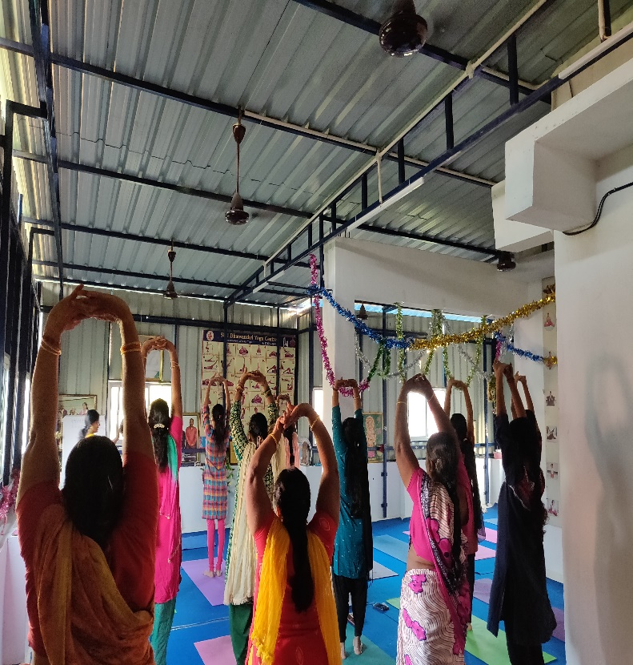
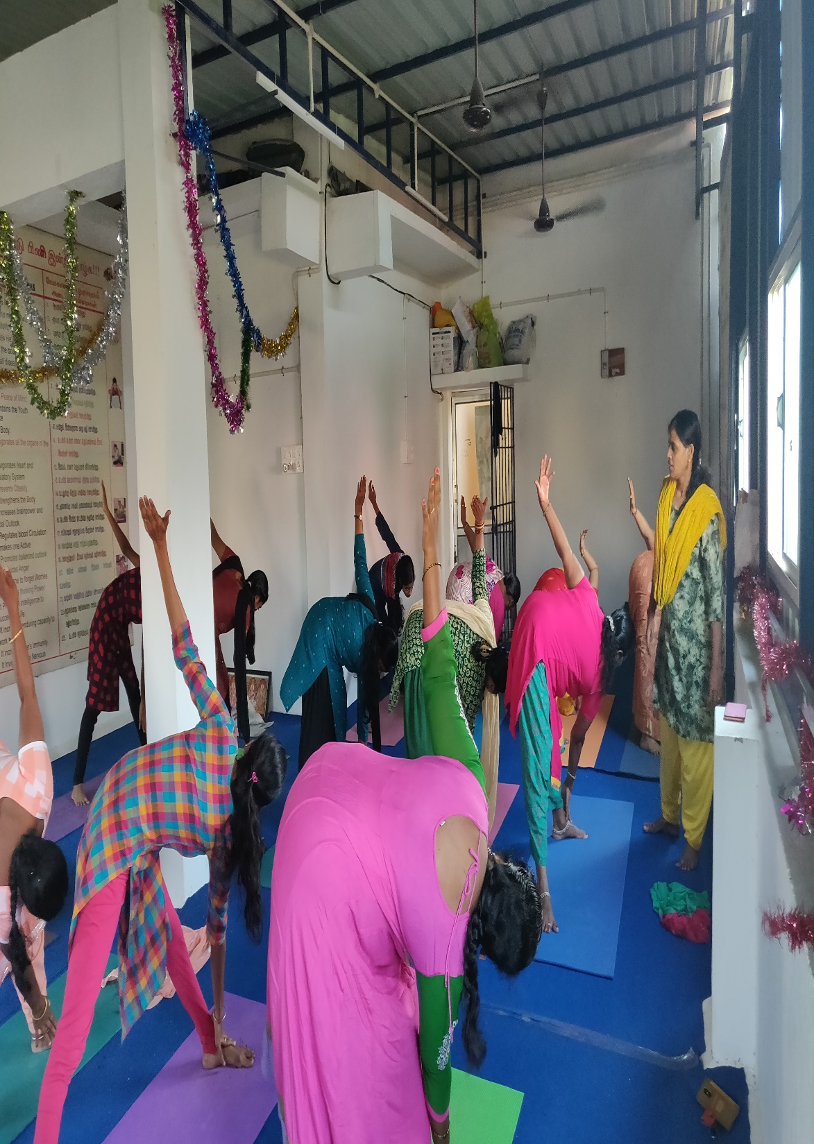
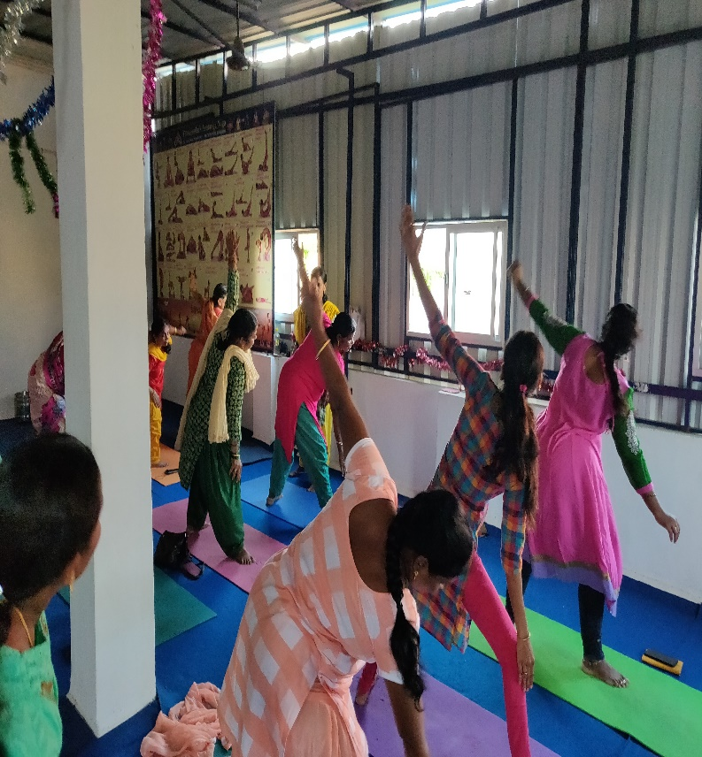

Slide 48

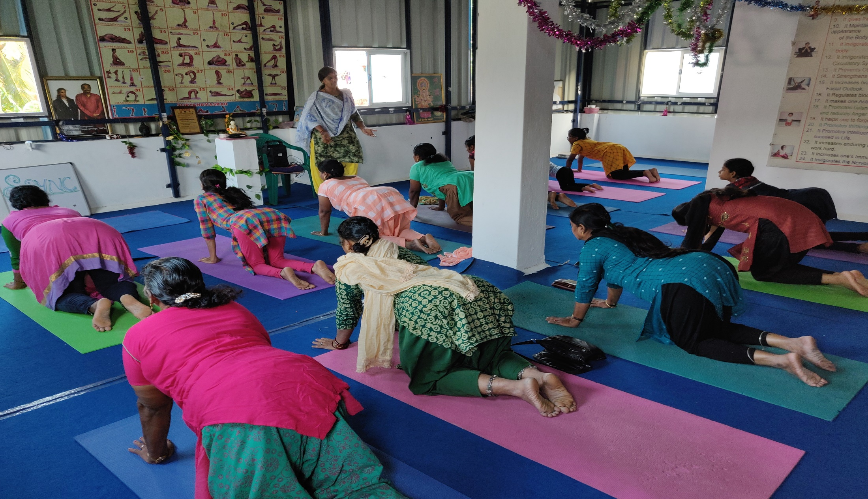

Slide 49


Slide 50
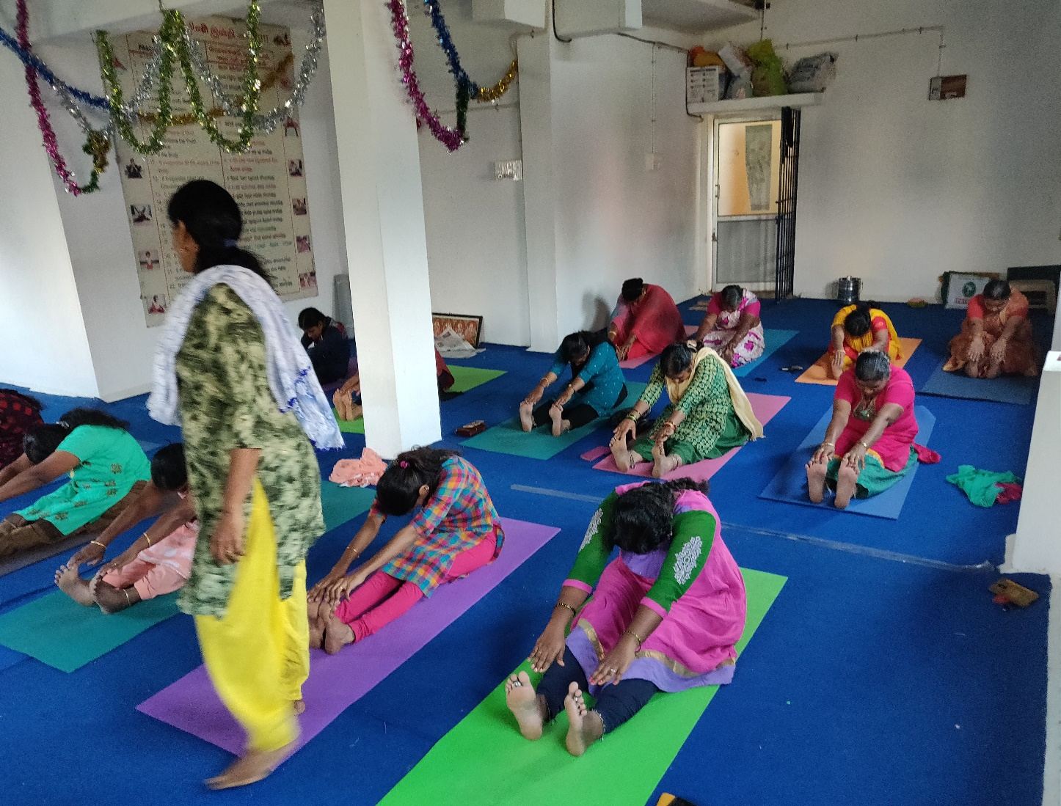

Slide 51
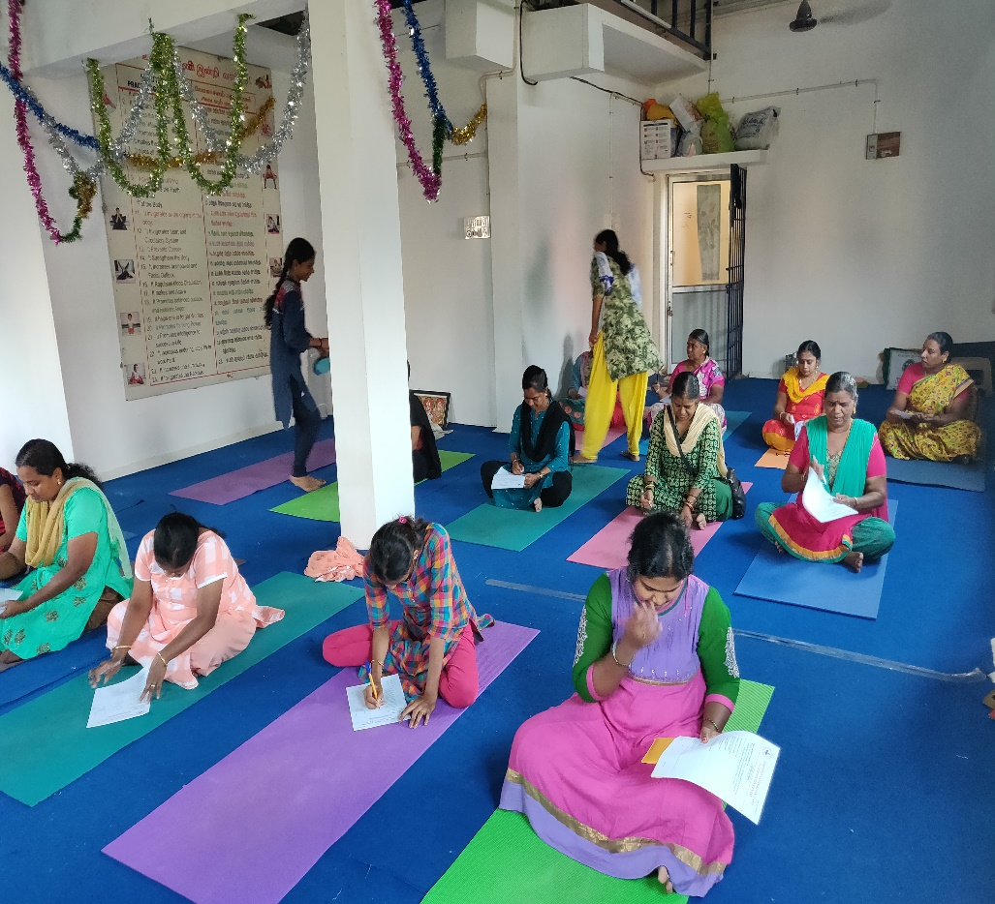
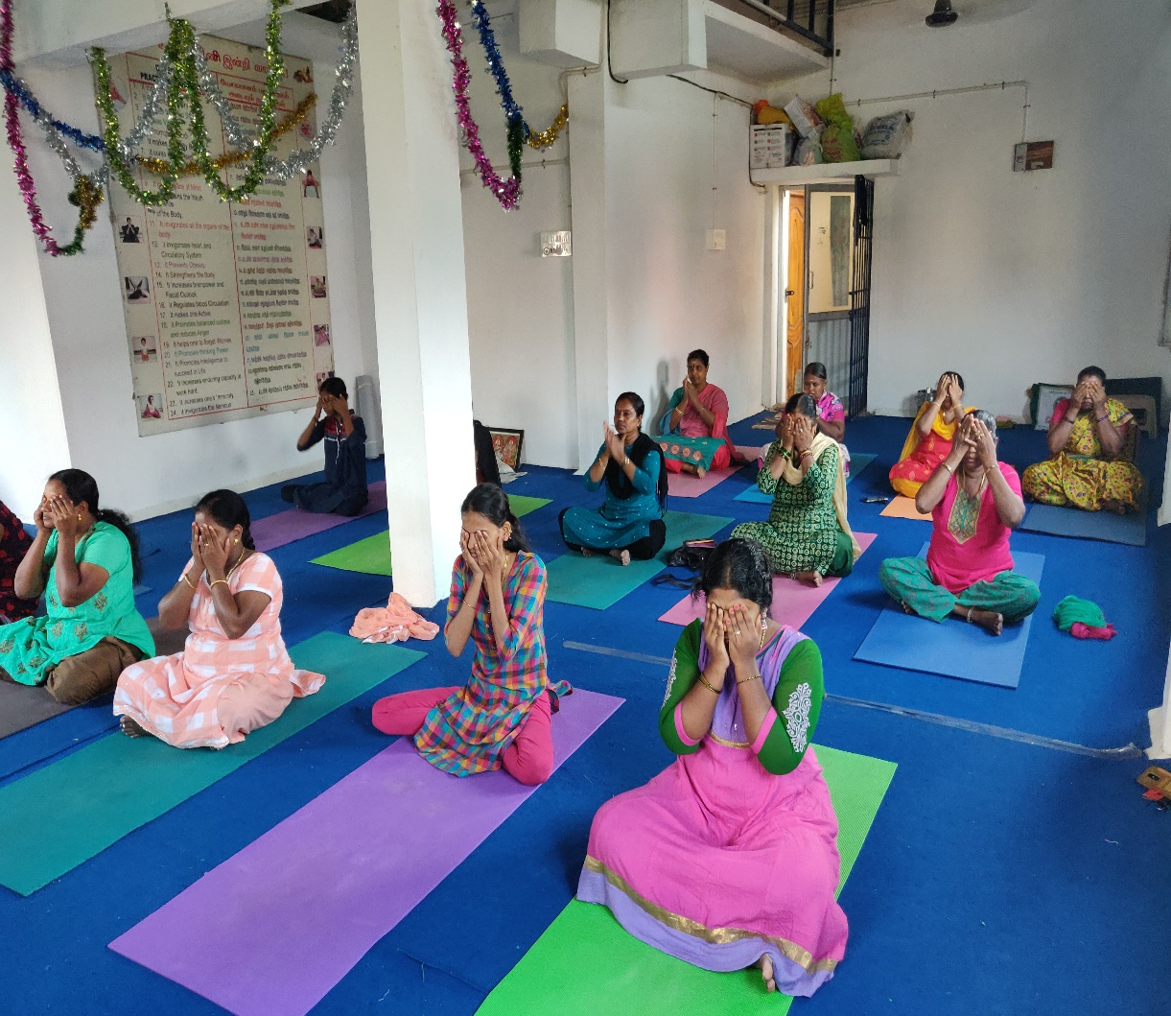

Slide 52

THANK YOU
FOR YOUR
PATIENT LISTENING

